Slide 1
Vaccines and Immunology

Slide 2
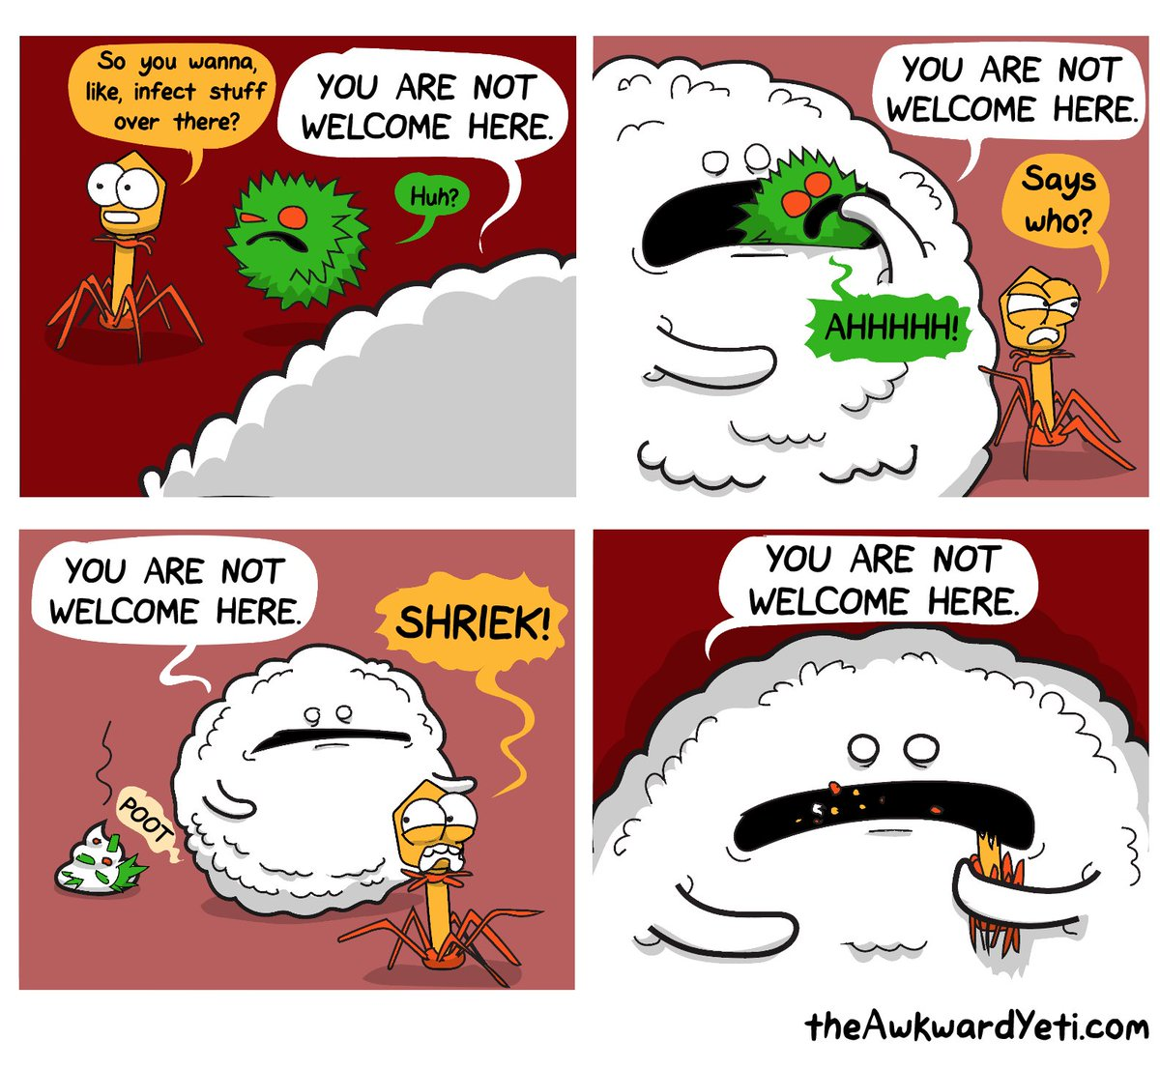

Slide 3
The Inflammatory Response
Inflammation is a response to any damage to the tissues.
The purposes of inflammation are to:
reduce the spread of any pathogens, to destroy them and to prevent the entry of additional pathogens.
remove damaged tissue and cell debris
begin repair of the damaged tissue

Slide 4
The Inflammatory Response
Words ending in –itis indicate inflammation of specific organs or tissues.
There are four signs of inflammation
Redness
Swelling
Heat
Pain

Slide 5
Why is it triggered?
Damage to tissues stimulates an integrated series of steps in the inflammatory response

Slide 6
Steps in the Inflammatory Response
Step 1: When stimulated by damage mast cells (special cells present in most tissues) stimulate and coordinate inflammation by releasing chemicals
Step 2: Histamine increases blood flow (causes heat and redness) through the area causing blood capillaries to become more permeable so fluid is filtered from blood (causes swelling).

Slide 7
Steps in the Inflammatory Response
Step 3: Heparin released from the mast cells prevents clotting in the immediate are of the injury. A clot of the fluid around the damaged area does form and this slows the spread of the pathogen.
Step 4: The chemicals released by the mast cells attract phagocytes. Macrophages and leucocytes actively consume micro-organisms and debris by phagocytes.

Slide 8
Steps in the Inflammatory Response
Step 5: The abnormal conditions in the tissue stimulate pain receptors, and so the person feels pain in the inflamed area.
Step 6: The phagocytes, filled with bacteria, debris and dead cells, begin to die. The dead phagocytes and tissue fluid form a yellow liquid called pus.

Slide 9
Steps in the Inflammatory Response
Step 7: New cells are produced by mitosis and repair of the damaged tissue takes place

Slide 10
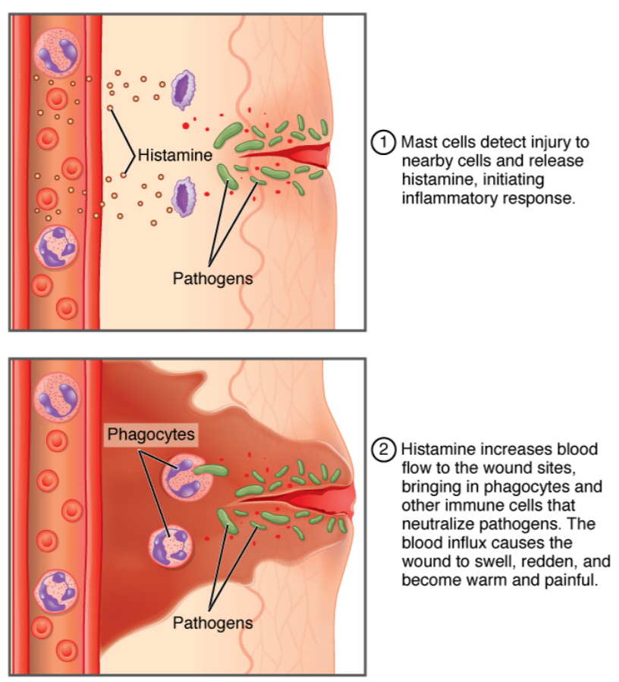

Slide 11
What is a Phagocyte?
Phagocytes are cells that engulf and digest micro-organisms and cell debris.
They are important in the defence against disease.

Slide 12
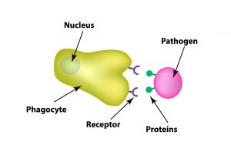

Slide 13
What is a Leucocyte?
They are white blood cells
They are able to leave the blood capillaries and migrate through the tissues to places of infection or injury
Some leucocytes secrete substances that destroy bacteria, whilst some engulf bacteria.

Slide 14
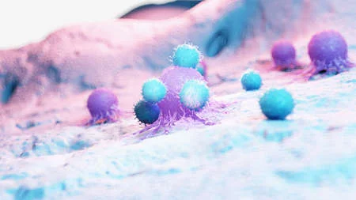
Cancer cell (Purple) being attacked by Leucocytes (Blue)

Slide 15
What is a Macrophage?
Large phagocytic cells that develop from some leucocytes
Some wander looking for pathogens to destroy, whilst others are fixed in one place and only deal with pathogens that approach them
They either engulf and digest the micro-organism or secrete substances to destroy them

Slide 16
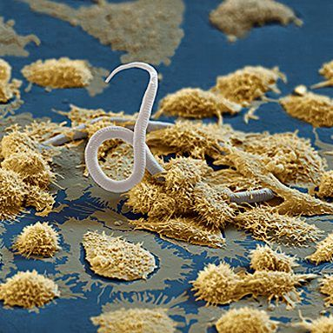
Scanning electromicrograph showing macrophages (yellow) attacking the larva of a parasitic worm transmitted via a mosquito bite

Slide 17
The Immune Response continued
The Immune Response is a homeostatic mechanism
When micro-organisms or foreign substances enter the body, the immune response helps to deal with the invasion and restore the internal environment to its normal condition.

Slide 18
Parts of the Immune Response
There are two parts to the Immune Response:
Anti-body mediated immunity: involves the production of special proteins called antibodies, which circulate around the body and attack invading agents
Cell-mediated response: involves formation of special lymphocytes that destroy invading agents.
Both involve lymphoid tissue which is mainly composed of two types of lymphocytes (B-cells and T-cells)

Slide 19
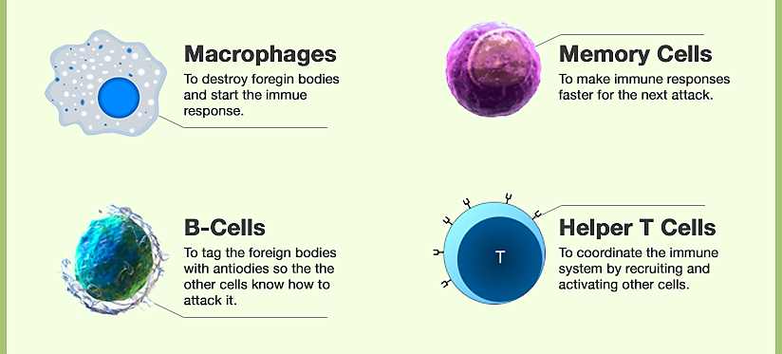

Slide 20
B-Cells and T-Cells
B- cells provide antibody-mediated immunity (antibodies) and T-cells provide cell-mediated immunity (no antibodies).

Slide 21
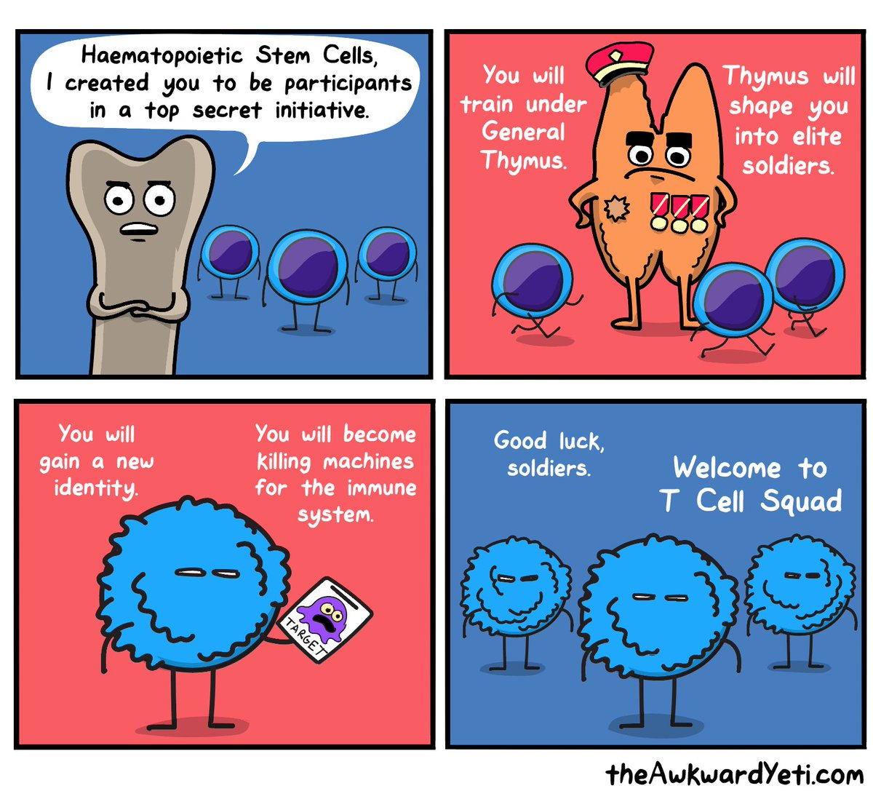

Slide 22
Antigens
Antibody-mediated and cell-mediated immunity are triggered by antigens.
An antigen is any substance capable of causing a specific immune response. Such a substance, introduced to the body, causes the body to produce specific antibodies.

Slide 23
Antigens continued
Antigens are large molecules.
Antigens are not necessarily micro-organisms.
Large molecules produced in a person’s own body do not cause an immune response. These are called self-antigens.
Foreign compounds that do trigger an immune response are non-self antigens. These will be attacked.

Slide 24
Antibodies
An antibody is a specialised protein that is produced in response to a non-self antigen. Antibodies belong to a group of proteins known as immunoglobulins.
The antibody produced in response to an antigen can combine with that antigen to form an antigen-antibody complex (like the Lock and Key model).

Slide 25
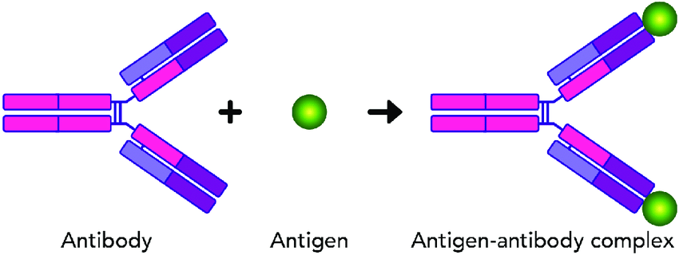

Slide 26
Antibody-mediated immunity
Humoral immunity is an antibody-mediated response that occurs when foreign material (antigens) are detected in the body.
This foreign material typically includes extracellular invaders such as bacteria.
This mechanism is primarily driven by B-cells (a type of immune cell that produces antibodies after the detection of a specific antigen).

Slide 27
Cell- mediated immunity
Cell-mediated immunity does not depend on antibodies for its immune functions.
Cell-mediated immunity is primarily driven by mature T cells, and macrophages.
T cells involved in cell-mediated immunity rely on antigen-presenting cells that contain proteins in order to recognize intracellular target antigens.

Slide 28
Cell-mediated immunity continued
Cell-mediated immunity typically comes into play at body sites where cells are infected by a virus, bacteria, or fungi (intracellular invaders).

Slide 29
Immunity
Immunity is resistance to infection by invading micro-organisms.
The body is able to response quickly enough to deal with any invasion by pathogenic micro-organisms.

Slide 30
Natural and Artificial Immunity
Natural: occurs without any human intervention.
Artificial: results from giving people an antibody or antigen.

Slide 31
Passive and Active Immunity
Natural and artificial immunity can be passive or active.
Passive: person is given antibodies produced by someone else. E.g. Mother’s antibodies are passed to child via breastmilk.
Active: results when the body is exposed to a foreign antigen and manufactures antibodies in response to that antigen.

Slide 32
Antibiotics
Used to fight infections of micro-organisms, particularly bacteria.
Each antibiotic is effective for only certain types of bacterial infection and cannot be used to treat viral infections.
There are two types of antibiotic:
Bactericidal: kill bacteria by changing the structure of the cell wall or membrane
Bacteriostatic: stop bacteria from reproducing

Slide 33
Antivirals
Specifically used for treating viral infections
Antivirals inhibit the development of the virus
Target viruses such as HIV, herpes, hepatitis B and C

Slide 34
Antiseptics
Widely used in health care to kill or stop the growth of microbes on the skin and mucous membranes. Also used before medical procedures, in treating minor wounds and cleaning hands.
E.g. Isopropyl alcohol, peroxide

Slide 35
Immunisation
Immunisation means programming the immune system so that the body can respond rapidly to infecting micro-organisms.
It can occur naturally (e.g. chickenpox) or artificially

Slide 36
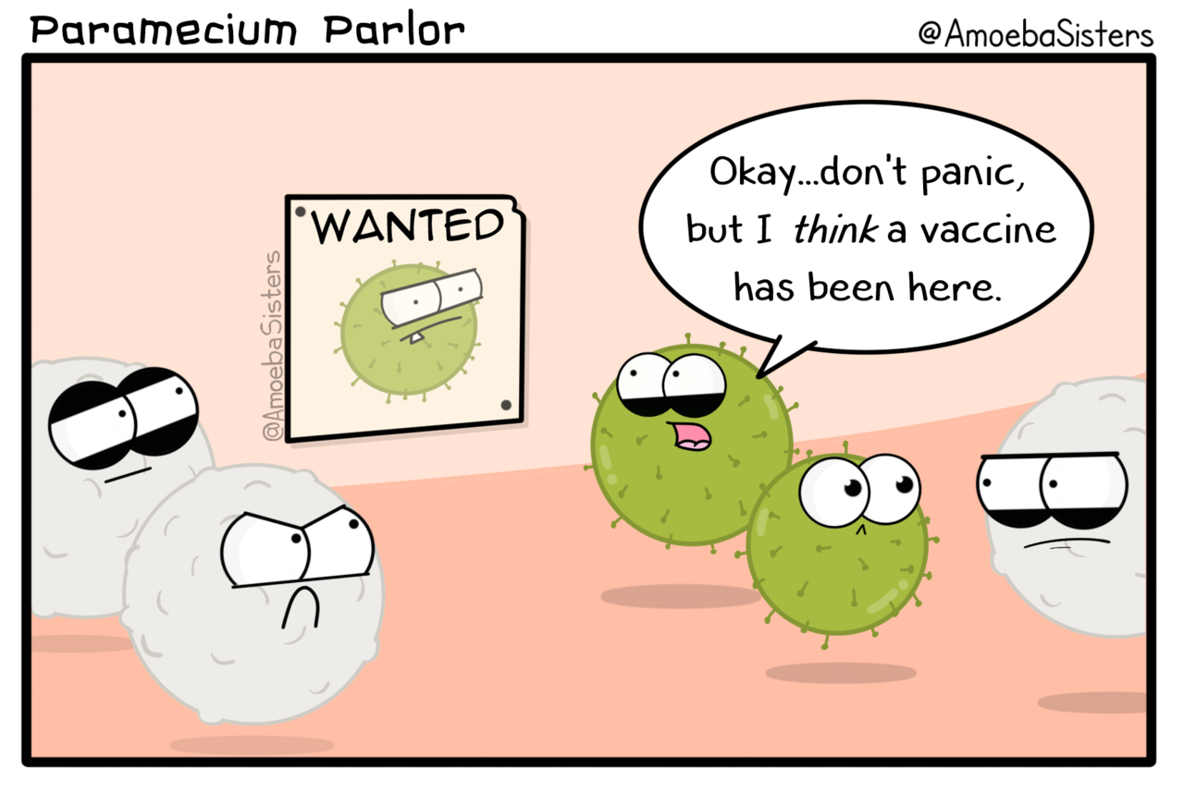

Slide 37
Immunisation continued.
Vaccination is the artificial introduction of antigens of pathogenic organisms so that the ability to produce the appropriate antibodies is acquired without the person having to suffer the disease.
A vaccine is the antigen preparation used in artificial immunisation. There are four types.

Slide 38
Type of Vaccine | Description | Vaccine used to protect against:
Living attenuated micro-organisms | Reduced virulence so you do not contract the disease but you manufacture antibodies against the antigen. | Measles, mumps, rubella
Dead micro-organisms | Produce antibodies against antigen but not as long lasting as using live attenuated micro-organisms. | Cholera, bubonic plague, influenza
Toxoids | Made from filtrates of bacterial cultures that are inactivated. | Diphtheria, tetanus
Sub-unit | A fragment of the organism is used to provoke an immune response. | HPV (human papilloma virus), hepatitis B

